Slide 1
iDJ Design Sketches
Version: 1.0
Date updated: 2008-02-02
Prepared by: Tom Söderlund
Security class: Internal

Slide 2
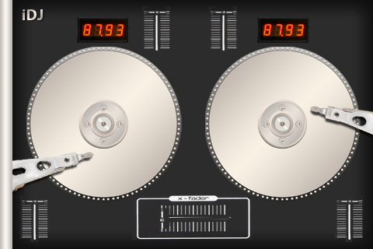
iDJ: User Interface Classes (suggestion)
FaderControl : UISliderControl or UIView
BPMControl : UIView
iDJView or UIView : UIView
TurntableButton : UIPushButton
TurntableControl : UIView
CrossfaderControl or FaderControl
: FaderControl or UISliderControl or UIView
FaderControl : UISliderControl or UIView

Slide 3
Clipart
Info
BigBox
Info
Note:
Bla bla bla
SmallBox
Info
Class
Data1
Data2
Todo:
Bla bla bla
Autosize text
Label:
Input Box
Link
Dialog Window
Menu text
John Doe
Button
Legend
Does not require login
Does require login
Prio 3, future release
Not designed yet

